Slide 1

JPF Verification of Habanero Java using Gradual Type Permission Regions
Peter Anderson Brigham Young University Provo, Utah anderson.peter@byu.edu | Nick Vrvilo Rice University Houston, Texas nv4@rice.edu
Eric Mercer Brigham Young University Provo, Utah egm@cs.byu.edu | Vivek Sarkar Rice University Houston, Texas vsarkar@rice.edu
Notes:
Introduction – My name and collaborators names
Put slide numbers on slides for practice talk

Slide 2
What is Habanero Java?
Programming Language with support for:
Lightweight Dynamic Task Creation Async Future Finish Async-Await … | Collective and Point-to-Point Synchronization Phasers Barriers Accumulators …
Mutual Exclusion and Isolation Isolated Actors | Locality Control Places Heirarchy
Notes:
Programming model compatible with Java with emphasis on safe, efficient, and usable concurrency constructs
Lightweight Tasks – Includes variations on async (future, DDF, etc) that fit more comfortably into different use cases
Collective and PnP Synchronization – Advanced synchronization between tasks
Mutual Exclusion – Creates a region of code that will execute in exclusion with any other conflicting isolated regions
Locality Control – Control over how program runs on a distributed system
Notes – Cover the slide in one pass

Slide 3
HJ Overview
Async – Creates a Lightweight Task
Finish -- Generalized Join Operation
Isolated – Mutual Exclusion
Phasers – Generalized Barriers
Notes:
1) Review of these words…they will come up often throughout the presentation

Slide 4
Async & Finish
L0: finish(() -> {
L1: async(() -> { // async 1 body });
L2: async(() -> { // async 2 body });
L3: });
L0
L1
A1
L2
A2
L3
Notes:
This is what habanero looks like
This is what makes using habanero easy

Slide 5
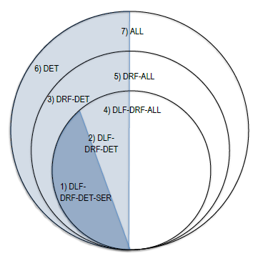
Safety Guarantees
Async
Finish
Isolated
Future
Phasers
Async
Finish
Future
Notes:
For subsets of the Habanero Java language there are associated safety guarantees. This, in combination with the general usability of HJ constructs, makes writing concurrent programs a simpler task. Thus opening up this paradigm to non-experts.
Discuss example of using subsets 1 and 4
Notes – Pull out slide

Slide 6
Guarantees Predicated Upon Data-race Freedom
Data Race
Determinism
Notes:
Safety Guarantees are predicated upon the program being free of data race
Thus this frames the problem of verification of HJ programs in terms of guaranteeing the absence of race conditions
This is a problem well suited for JPF. All versions of HJ compile to JVM compatible bytecode and JPF has many tools for doing this type of verification
However, to solve this problem we needed to first produce our own runtime – (Why? Runtime independent results. Natural scheduling points)

Slide 7
VR
Notes:
Two goals of VR
Quick mapping from HJ to VR
Two goals with VR:
Integrate nicely with JPF
Small and simple as possible

Slide 8
HJ-V
HJ
HJ-V
Dynamic Task
Creation
1-to-1 Thread to Task Relationship
Mutual Exclusion
and Isolation
Single Global Lock
Collective and
Point-to-Point
Synchronization
Implemented with
Conditions on Locks
Java 8 Compatible
Lambda Interface
Single Method
Anonymous Inner
Classes
Notes:
HJ-V is a stand-alone runtime that can be used to correctly support Habanero Java applications.
HJ-V was intended to be run within JPF.

Slide 9
VR-lib
Notes:
With the introduction of HJ-lib we decided to follow suit and transitioned VR to a Java compatible library interface.
Note the additions of phasers (implemented with conditions on locks)
Compatible Java 8 Library
Addition of Phasers
Notes – Show mapping from HJ to HJ-lib
1. Merge slide 7 & 8
2. Remove phasers
3. Change VR to HJ-V
4. We implemented HJ-V to run stand-alone

Slide 10
Narrowing Our Focus
From
To
Bytecode Level Race Detection
Generic Scheduler
Intended for Variety of Java
Block Level Race Detection
2. Specialized Scheduler
Intended for Habanero Java
Notes:
1.

Slide 11
Gradual Permission Regions
Notes:
GPRs annotate shared variable over a block of code. With a GPR a HJ task can assert to the runtime the type of access (read/write) it intends with the shared variable
If two tasks simultaneously assert conflicting access this will produce a permission violation and the runtime will throw an exception
Note, GPRs do not enforce mutual exclusion. They do not provide any level of task synchronization. They are simply permission assertions.

Slide 12
releaseW
Null
acquireW
Private Write
Private Read
Shared Read
Permission
Violation

Slide 13
Notes:
GPRs depend upon keeping track of the permission state on every variable contained with a GPR. The permission state of the object is tracked via this state machine.
Walk through different states
Notes –
We track the permission state of the object with state machine. 1 for every object in permission region. acquire/release statements make transitions on the state.
Modify to remove illegal transition (no transition from Shared Read to NULL

Slide 14
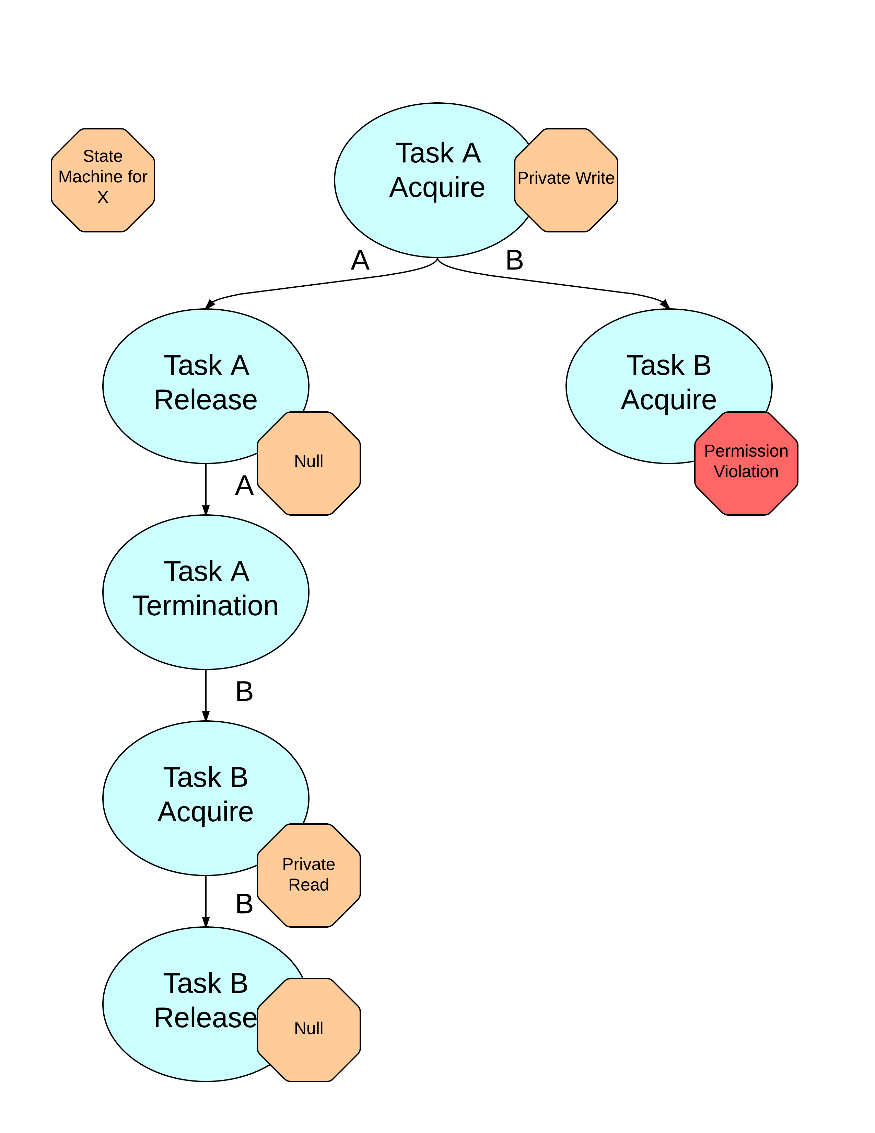
// Task A
public Node pop() {
acquireW(this);
Node ret = this.pop();
releaseW(this);
return ret;
}
// Task B
public boolean empty() {
acquireR(this);
boolean ret = (! size > 0);
releaseW(this);
return ret;
}
Notes:
We have two stack methods on the left. Pop asserts write permissions and empty asserts read permissions.
Walk through example
Note –
Task A/B label
This will be my example from slide 11

Slide 15
JPF Implementation
What do need to support GPRs in VR-lib?
Track permission state of GPR variables
Update permission state on every acquire/release assert
Restore permission state upon backtracking
How can JPF help us with this problem?

Slide 16
Attribute Infos
Attribute Infos support attaching one or more arbitrary objects to objects on the heap
Attribute Infos are restored upon backtracking
Perfect fit for implementing GPRs in JPF
We attach a state machine to every object that is annotated with a GPR.
Notes:
Although JPF restores attribute infos upon backtracking it only performs a shallow copy. Thus to support attaching a complex data structure to the heap object we have made our state machine totally immutable. Transitions on the state machine are emulated by producing a new machine with the transition represented.
Notes –
Attribute objects are meta objects that attach to concrete heap objects
GPRs are implemented without modification to HJ-V. We rely upon the hooks that JPF offers to support this

Slide 17
Listeners
When an acquire statement is executed…
HjListener inserts a scheduling point into the state space via a choice generator (all runnables enabled)
HjListener computes transitions on the state machine which is attached to an object on the heap
When a release statement is executed…
Same as above except no scheduling point is inserted
Notes:
Notes –
1.

Slide 18
Scheduler
Sync Policy | Sharedness Policy
Thread API | Shared Class
Garbage Collection | Shared Object
Root CG | Shared Array
Object API
Notes:
Currently JPF’s default behavior is to insert scheduling points for Thread Synchronization and Shared State
With GPRs we don’t want JPF to insert any scheduling points for shared state
Notes –
Grey out/strike-through removed items
Add in GPR regions
Why this is faster? Include bytes code figure… Put this here
Bold table headers
Create a slide after this one that shows JPF/GPR difference in inserting choice generators.

Slide 19
Scheduler
Sync Policy | Sharedness Policy
Thread API | Shared Class
Garbage Collection | Shared Object
Root CG | Shared Array
Object API | Gradual Permission Regions
Notes:
Currently JPF’s default behavior is to insert scheduling points for Thread Synchronization and Shared State
With GPRs we don’t want JPF to insert any scheduling points for shared state
Notes –
Grey out/strike-through removed items
Add in GPR regions
Why this is faster? Include bytes code figure… Put this here
Bold table headers
Create a slide after this one that shows JPF/GPR difference in inserting choice generators.

Slide 20
Bytecode vs. Block
Bytecode Access
Code:
12: getfield #5 // Field x
22: getfield #7 // Field y
32: getfield #8 // Field z
Block Access
Code:
-- acquireR/W –
12: getfield #5 // Field x
22: getfield #7 // Field y
32: getfield #8 // Field z
-- releaseR/W –
Scheduling Point
Scheduling Point

Slide 21
Scheduler
Sync Policy | Sharedness Policy
Thread API
Garbage Collection
Root CG
Object API
Notes:
Shared access choice generators (class, object, array) are only used by JPF to detect data race via PreciseDataListener. GPR is theory will replace this system and thus all of these types of choice generators can be turned off.
There is still much improvement to be had in terms of optimizing the scheduler. Currently we still rely upon JPF’s default scheduling behavior much more than we need to. This is an area for future improvement for verifying HJ programs with JPF.

Slide 22
Results
 |  | GPR |  | PRD
Benchmark | Tasks | States | Time (s) | States | Time (s)
ConcReaders | 2 | 168 | 00:00 | 1,977 | 00:01
PermStackFin | 2 | 248 | 00:00 | 3,682 | 00:02
PermStackIso | 2 | 1,751 | 00:02 | 64,879 | 00:18
PhaserTest | 2 | 29,480 | 00:16 | 2,240,530 | 15:37
Notes:
As synchronization complexity increases so does the size of the state space
Removing shared access choice generators reduces the state space by 1-2 orders of magnitude

Slide 23
Conclusions
HJ-V is a stand-alone runtime library that can be run within JPF to verify Habanero Java applications
The use of GPRs in the verification of Habanero Java applications is a nice way to reduce the state space.

Slide 24
Future Work
Optimized scheduler that inserts choice generators minimally for verification of HJ programs with GPR
GPRs explicitly outline dependencies or regions – thus making a partial order reduction very feasible
Shift the burden of annotation from programmer to a static analysis tool (existing work has been done for this)
Notes:
Notes –
1. Habanero group has already done work on automatically inserting annotations

Slide 25
Questions?

